Slide 1
Statistical Learning
PGPBDA

Slide 2
Outline
Introduction to Probability
Types of Probability
Bayes Theorem and its Applications
Binomial Distribution
Poisson Distribution
Normal distribution
Chi-square distribution
Student’s t-distribution
Summary of applications of different distributions

Slide 3
Introduction
Managers will have to cope with uncertainty in many decision situations. Concepts of probability will help you measure uncertainty and perform associated analyses that are essential in making effective business decisions.

Slide 4
Question
What is the probability that a man lives for 1000 years?
Ans – Empirical Probability

Slide 5
Probability – Meaning & Concepts
Probability refers to chance or likelihood of a particular event-taking place.
An event is an outcome of an experiment.
An experiment is a process that is performed to understand and observe possible outcomes.
Set of all outcomes of an experiment is called the sample space.

Slide 6
Example
In a manufacturing unit three parts from the assembly are selected. You are observing whether they are defective or non-defective. Determine
a) The sample space.
b) The event of getting at least two defective parts.

Slide 7
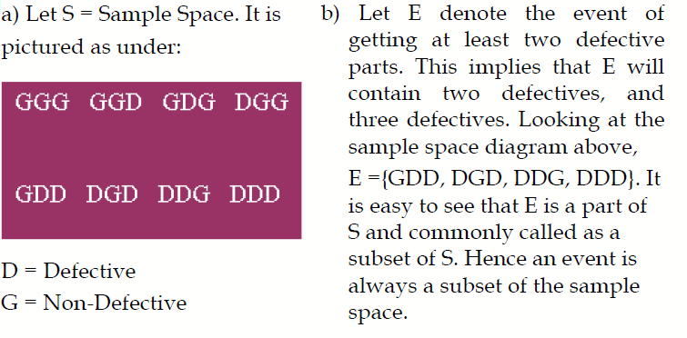
Solution

Slide 8
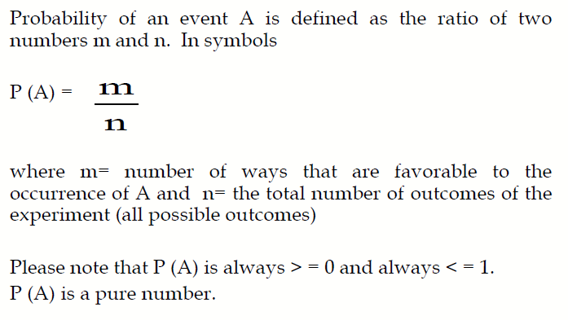
Definition of Probability

Slide 9
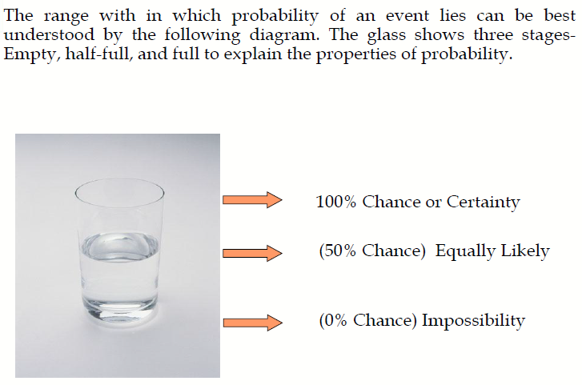
3 Extreme Values of Probability

Slide 10
Types of Probability
A Priori Classical Probability
Empirical Probability
Subjective Probability

Slide 11
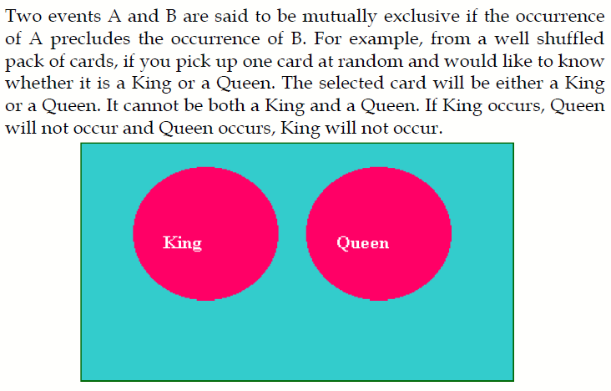
Mutually Exclusive Events

Slide 12
Independent Events
Two events A and B are said to be independent if the occurrence of A is in no way influenced by the occurrence of B. Likewise occurrence of B is in no way influenced by the occurrence of A.

Slide 13
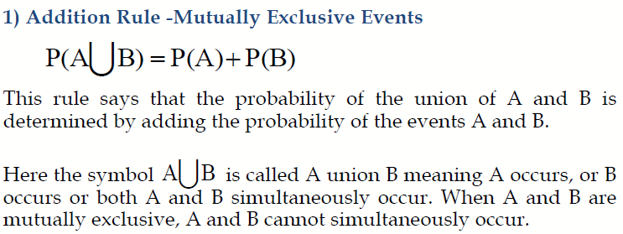
Rules for Computing Probability

Slide 14
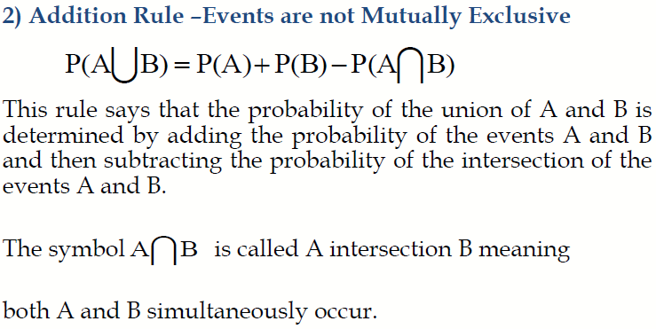
Rules for Computing Probability

Slide 15
Example for Addition Rules
From a pack of well-shuffled cards, a card is picked up at random.
What is the probability that the selected card is a King or a Queen?
What is the probability that the selected card is a King or a Diamond?

Slide 16
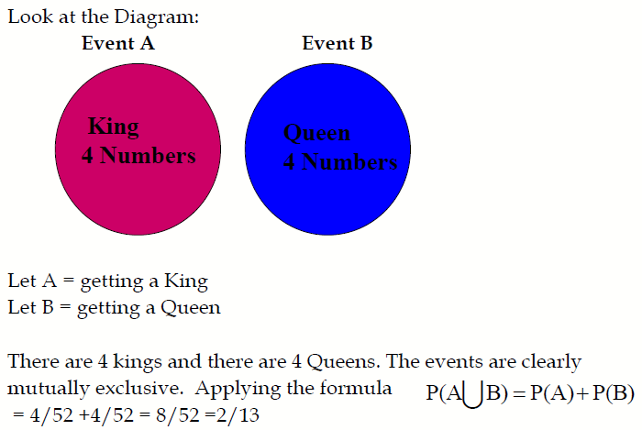
Solution to Part 1)

Slide 17
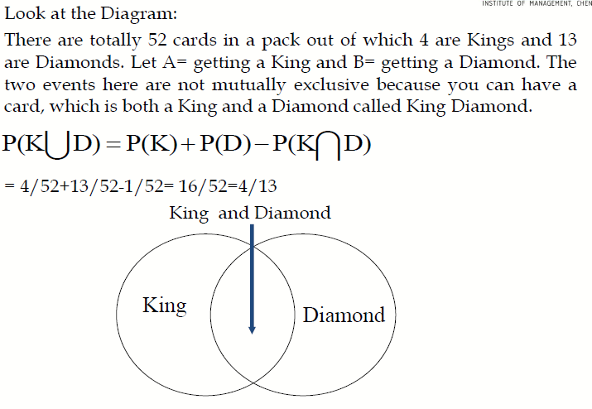
Solution to part 2)

Slide 18
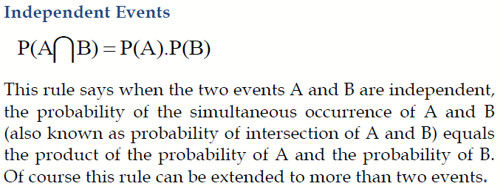
Multiplication Rule

Slide 19
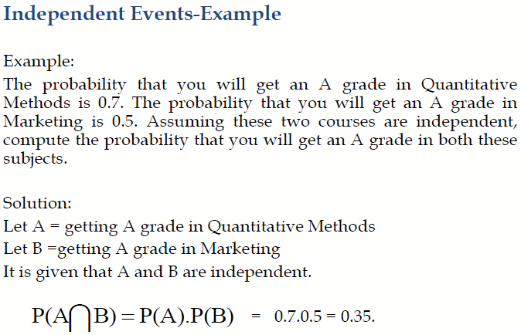
Multiplication Rule

Slide 20
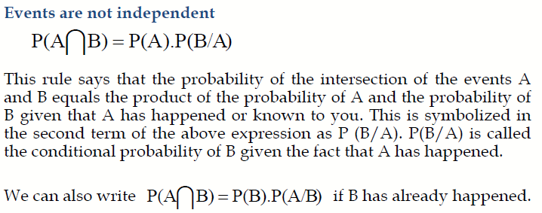
Multiplication Rule

Slide 21
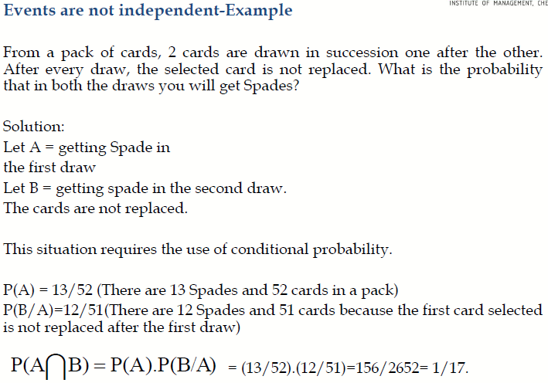
Multiplication Rule

Slide 22
Marginal Probability
Contingency table consists of rows and columns of two attributes at different levels with frequencies or numbers in each of the cells. It is a matrix of frequencies assigned to rows and columns.
The term marginal is used to indicate that the probabilities are calculated using a contingency table (also called joint probability table).

Slide 23
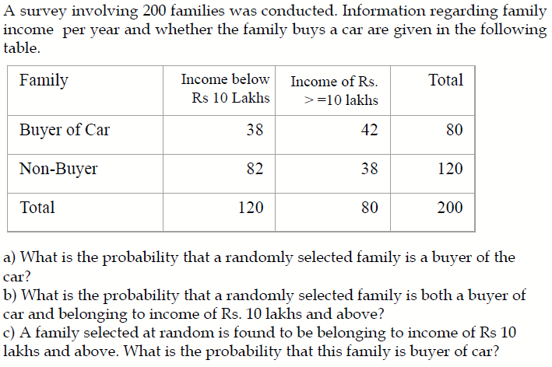
Marginal Probability - Example

Slide 24
Solution
a) What is the probability that a randomly selected family is a buyer of the Car?
80/200 =0.40.
b) What is the probability that a randomly selected family is both a buyer of car and belonging to income of Rs. 10 lakhs and above?
42/200 =0.21.
c) A family selected at random is found to be belonging to income of Rs 10 lakhs and above. What is the probability that this family is buyer of car?
42/80 =0.525. Note this is a case of conditional probability of buyer given income is Rs. 10 lakhs and above.

Slide 25
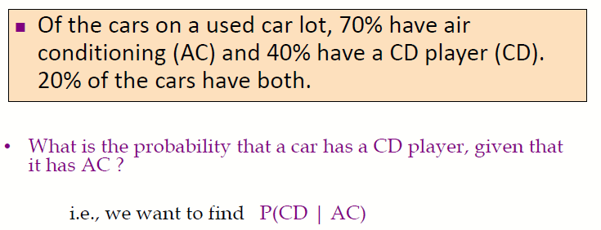
Marginal Probability - Problem

Slide 26
Bayes’ Theorem
Bayes’ Theorem is used to revise previously calculated probabilities based on new information.
Developed by Thomas Bayes in the 18th Century.
It is an extension of conditional probability.

Slide 27
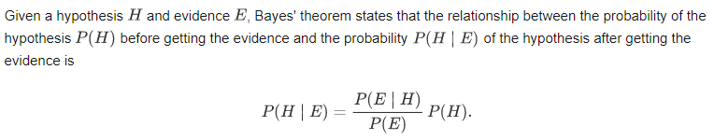
Bayes’ Theorem
Many modern machine learning techniques rely on Bayes' theorem. For instance, spam filters use Bayesian updating to determine whether an email is real or spam, given the words in the email. Additionally, many specific techniques in statistics, such as calculating p-values or interpreting medical results, are best described in terms of how they contribute to updating hypotheses using Bayes' theorem.

Slide 28
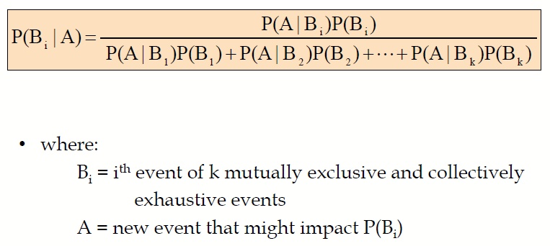
Bayes’ Theorem

Slide 29
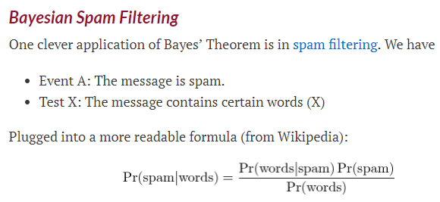
Bayes’ Theorem - Example

Slide 30
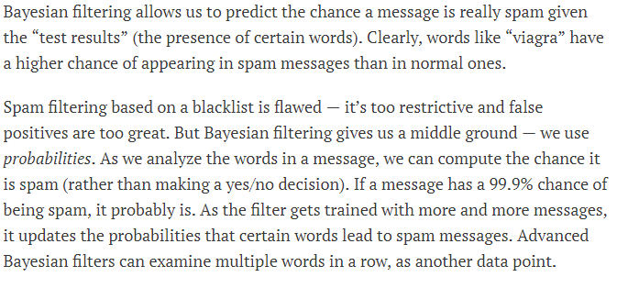
Bayes’ Theorem - Example

Slide 31
Bayes’ Theorem - Problem
A drilling company has estimated a 40% chance of striking oil for their new well.
A detailed test has been scheduled for more information. Historically, 60% of successful wells have had detailed tests, and 20% of unsuccessful wells have had detailed tests.
Given that this well has been scheduled for a detailed test, what is the probability that the well will be successful?

Slide 32
Association of Attributes
Of 37 men and 33 women, 36 are teetotalers (completely abstain from alcoholic beverages). Nine of the women are non-smokers and 18 of the men smoke but do not drink. 13 of the men and seven of the women drink but do not smoke.
How many, both drink and smoke? What is the associated probability?

Slide 33
What is a Probability Distribution
In precise terms, a probability distribution is a total listing of the various values the random variable can take along with the corresponding probability of each value. A real life example could be the pattern of distribution of the machine breakdowns in a manufacturing unit.
The random variable in this example would be the various values the machine breakdowns could assume.
The probability corresponding to each value of the breakdown is the relative frequency of occurrence of the breakdown.
The probability distribution for this example is constructed by the actual breakdown pattern observed over a period of time. Statisticians use the term “observed distribution” of breakdowns.

Slide 34
Binomial Distribution
The Binomial Distribution is a widely used probability distribution of a discrete random variable.
It plays a major role in quality control and quality assurance function. Manufacturing units do use the binomial distribution for defective analysis.
Reducing the number of defectives using the proportion defective control chart (p chart) is an accepted practice in manufacturing organizations.
Binomial distribution is also being used in service organizations like banks, and insurance corporations to get an idea of the proportion customers who are satisfied with the service quality.

Slide 35
Defective vs Defects
In a 1000 lines Code Program, if n number of lines have problems, it is called defective
However, the type of problem in each problematic line is called a defect
Binomial deals with defective analysis, while poisson deals with the number of defects
A computer is said to be defective. Binomial
The type of defects in each defective computer. Poisson

Slide 36
Defective vs Defects
Preparing a Project Report
Number of Defective pages in the Report – Binomial (Defective/Non Defective)
Number of defects per page – Poisson
We could say - Without Poisson , there is no Binomial
Binomial deals with % defective
Poisson deals with number of defects per item
Number of people arriving at an atm - Poisson

Slide 37
Defective vs Defects
Bank – Dissatisfied Customers percentage is Binomial
Number of complaints made by each customer – Poisson
Ashok Leyland chooses Leather covers
Defective covers – Binomial
Types of Defects in each cover – black spots, thread cuts etc - Poisson

Slide 38
Conditions for Applying Binomial Distribution (Bernoulli Process)
Trials are independent and random.
There are fixed number of trials (n trials).
There are only two outcomes of the trial designated as success or failure.
The probability of success is uniform through out the n trials

Slide 39
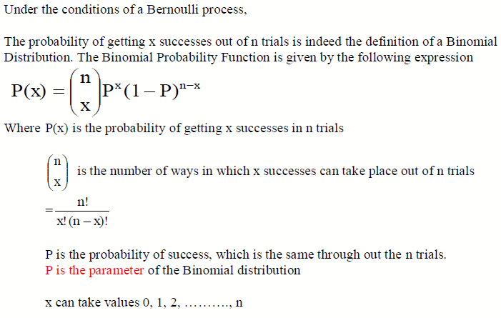
Binomial Probability Function

Slide 40
Example for Binomial Distribution
A bank issues credit cards to customers under the scheme of Master Card. Based on the past data, the bank has found out that 60% of all accounts pay on time following the bill. If a sample of 7 accounts is selected at random from the current database, construct the Binomial Probability Distribution of accounts paying on time.
Work Out Using R program

Slide 41
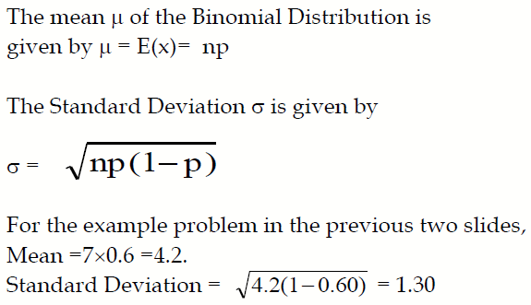
Mean and Standard Deviation of the Binomial Distribution

Slide 42
Poisson Distribution
Poisson Distribution is another discrete distribution which also plays a major role in quality control in the context of reducing the number of defects per standard unit.
Examples include number of defects per item, number of defects per transformer produced, number of defects per 100 m2 of cloth, etc.
Other real life examples would include 1) The number of cars arriving at a highway check post per hour; 2) The number of customers visiting a bank per hour during peak business period.

Slide 43
Poisson Process
The probability of getting exactly one success in a continuous interval such as length, area, time and the like is constant.
The probability of a success in any one interval is independent of the probability of success occurring in any other interval.
The probability of getting more than one success in an interval is 0.

Slide 44
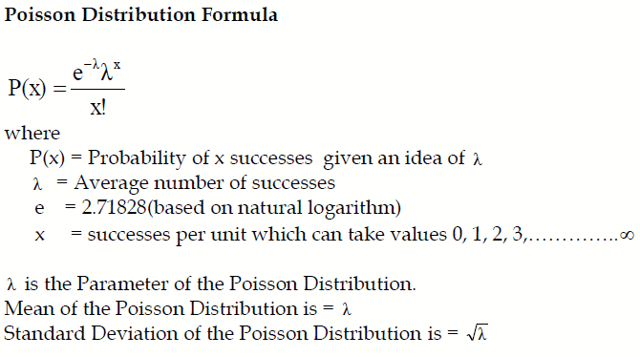
Poisson Probability Function

Slide 45
Example – Poisson Distribution
If on an average, 6 customers arrive every two minutes at a bank during the busy hours of working, a) what is the probability that exactly four customers arrive in a given minute? b) What is the probability that more than three customers will arrive in a given minute?
Work out using R program

Slide 46
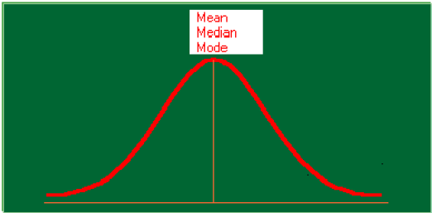
Normal Distribution

Slide 47
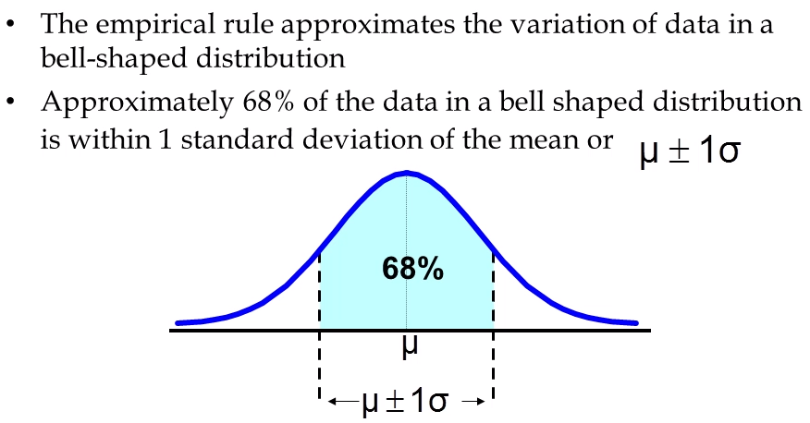
Normal Distribution

Slide 48
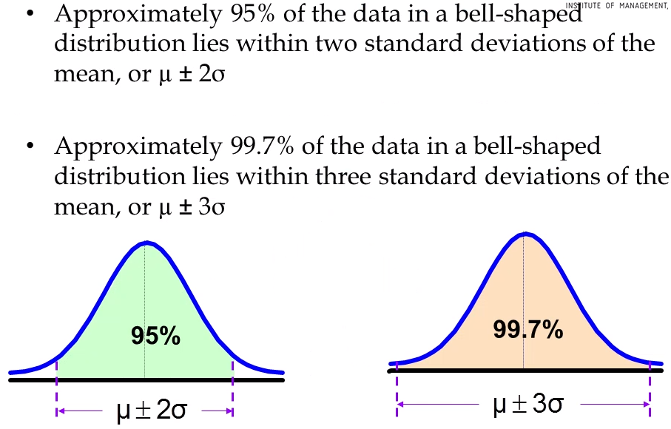
Normal Distribution

Slide 49
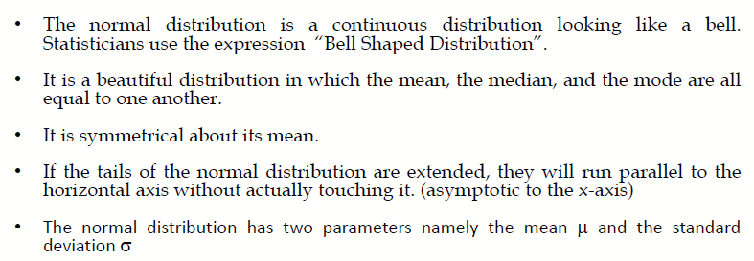
Properties of Normal Distribution

Slide 50
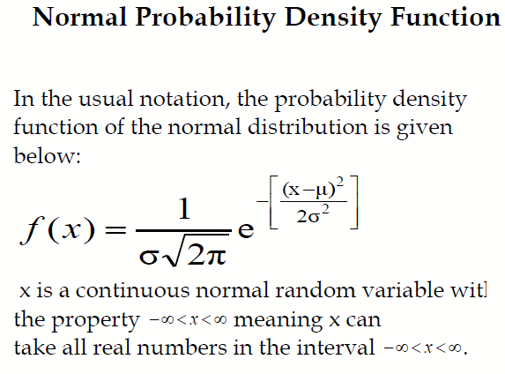

Slide 51
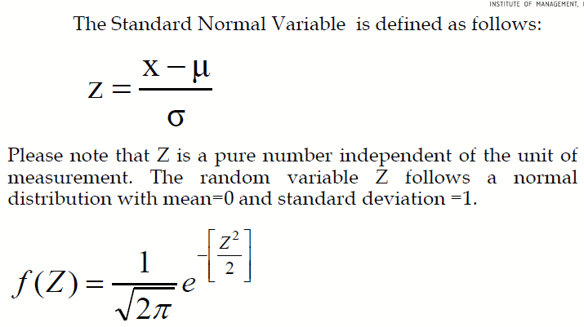
Standard Normal Distribution

Slide 52
Example Problem
The mean weight of a morning breakfast cereal pack is 0.295 kg with a standard deviation of 0.025 kg. The random variable weight of the pack follows a normal distribution.
a)What is the probability that the pack weighs less than 0.280 kg?
b)What is the probability that the pack weighs more than 0.350 kg?
c)What is the probability that the pack weighs between 0.260 kg to 0.340 kg?

Slide 53
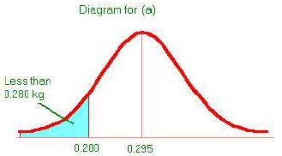
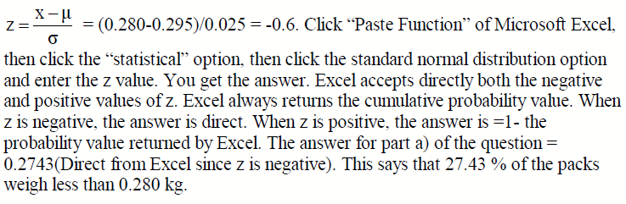
Solution a)

Slide 54
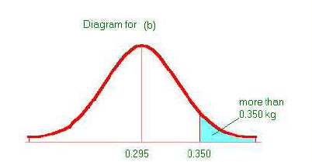
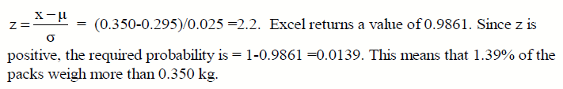
Solution b)

Slide 55
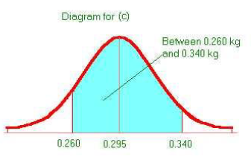
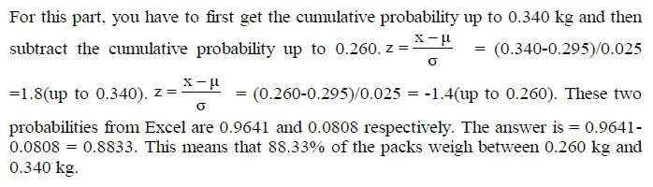
Solution c)

